Slide 1

Customer Feedback Analysis Project BY TEAM BRAVO

Slide 2
AGENDA
Introduction
Objectives
Dashboard
Insights and Recommendations

Slide 3
Introduction Customer feedback analysis using web scraping and sentiment analysis aimed at data-driven business insights.

Slide 4
Objectives
This project aims to collect and analyze customer feedback from
e-commerce platforms, social media, and review sites to derive actionable insights that can improve business decision-making.
The project will leverage web scraping, data engineering, sentiment analysis, and business analytics to identify customer satisfaction trends and provide recommendations for business improvement.

Slide 5
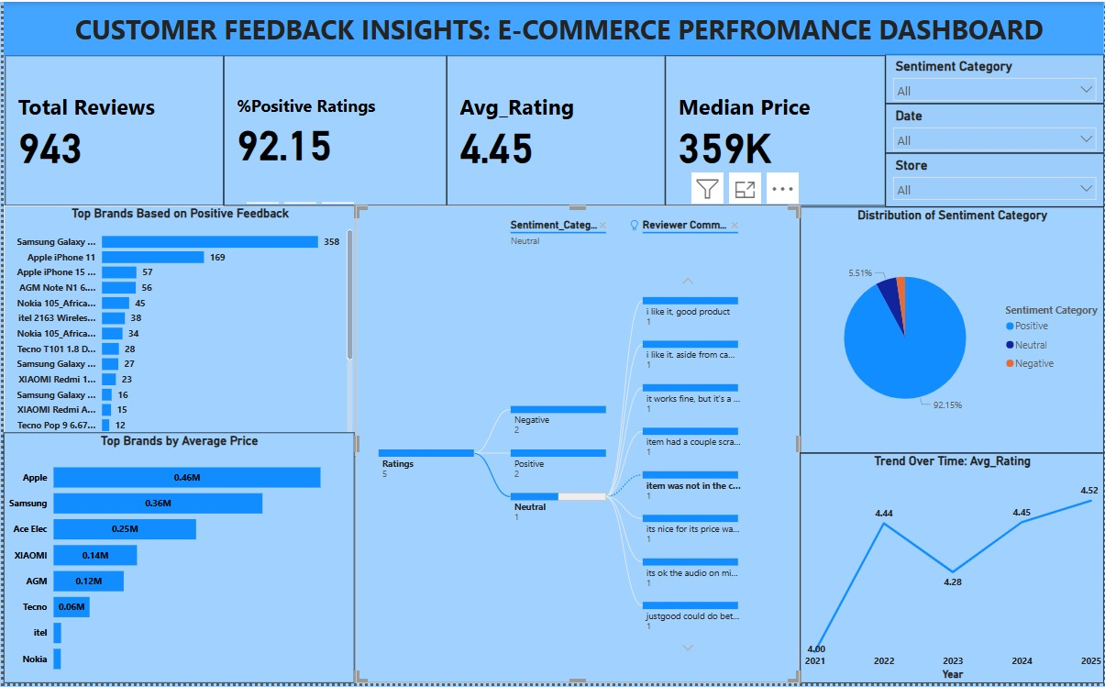
DASHBOARD

Slide 6
DASHBOARD ANALYSIS
Overall Positive Sentiment:
A very high percentage of positive ratings (92.15%) and a low percentage of negative ratings (2.33%) indicate strong overall customer satisfaction.
The average rating of 4.45 (assuming a scale of 1-5) reinforces this positive sentiment.

Slide 7
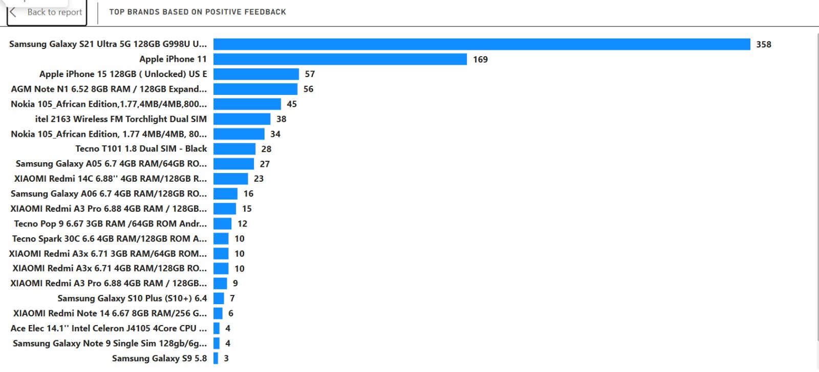
DASHBOARD ANALYSIS
Top Brands and Products:
Samsung Galaxy and Apple iPhones dominate the top brands based on positive feedback, showing their strong market presence and customer preference.
The Nokia 105 Africa and Itel 2163 wireless, and Tecno T101 1.8 28 shows that there is a strong customer base for lower priced, more basic phones.

Slide 8
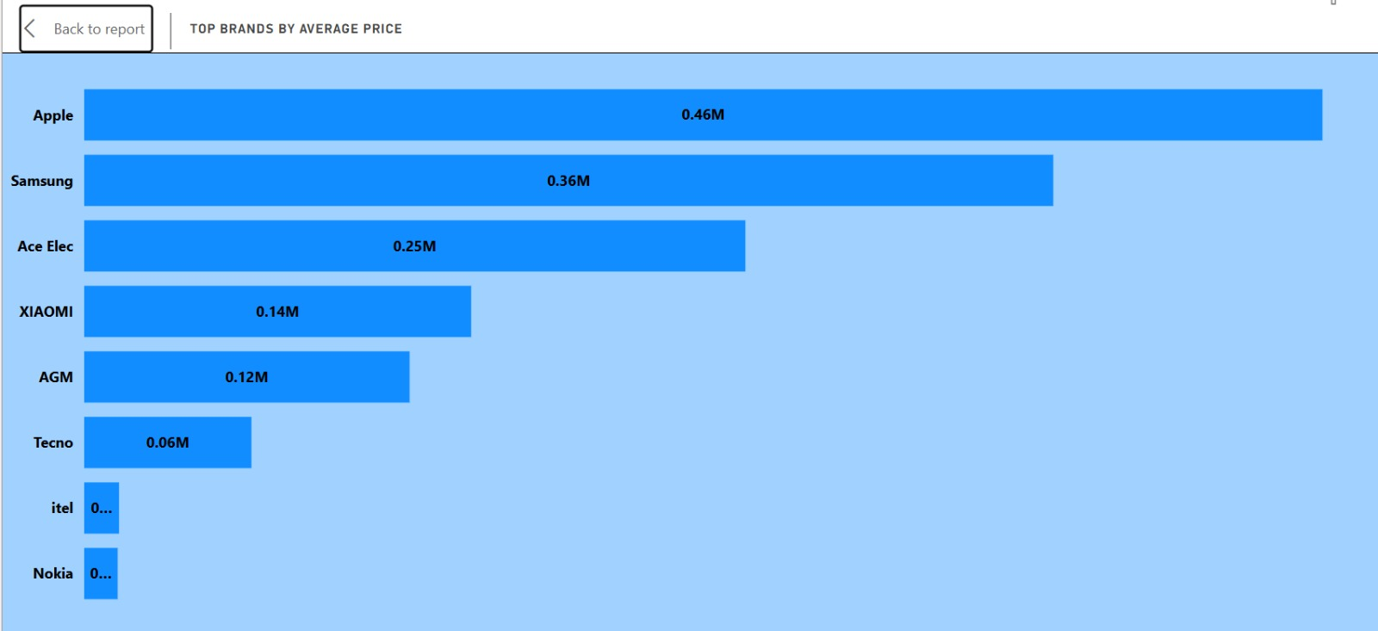
DASHBOARD ANALYSIS
Price Dynamics:
Apple products command the highest average price, followed by Samsung, indicating a premium brand positioning.
There is a large disparity between Apple and Samsung pricing, and the other brands listed.
The median price of 359K suggests a mid-range market, but the top brands influence this heavily.

Slide 9
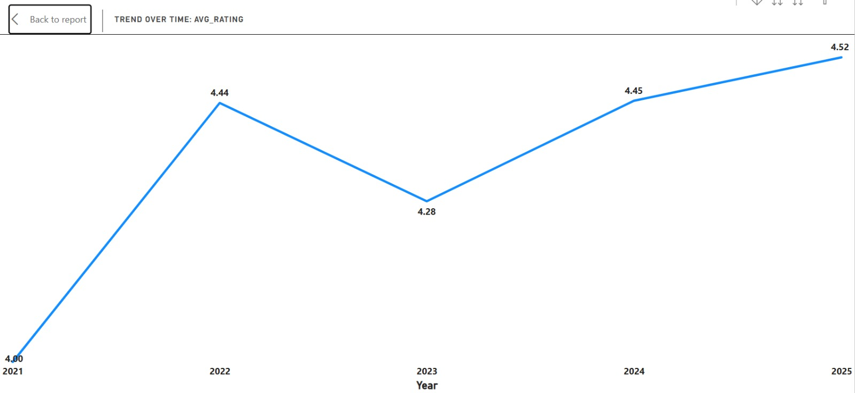
DASHBOARD ANALYSIS
Trend Over Time:
The average rating has shown a positive trend over time, especially from 2021 to 2025. This indicates a potential improvement in product quality, customer service, or both.
Review Volume:
Total reviews of 943, this should be taken into consideration when making decisions. If this is over a long period of time, then the amount of reviews could be increased.

Slide 10

INSIGHTS AND RECOMMENDATIONS
1. Capitalize on Positive Sentiment:
Insight: Leverage the high positive sentiment in marketing campaigns and customer testimonials.
Recommendation: Highlight positive reviews and ratings on product pages and in advertisements. Implement a customer loyalty program to reward satisfied customers.

Slide 11

INSIGHTS AND RECOMMENDATIONS
2. Optimize Brand Strategy:
Insight: Samsung and Apple are clear market leaders.
Recommendation: Analyze the specific features and attributes that contribute to the popularity of Samsung and Apple products. For other brands, focus on niche markets or value propositions that differentiate them. For example, the Nokia and Itel brands show there is a customer base for very low cost, basic phones.
Recommendation: Increase marketing for the lower cost phones, to increase sales.

Slide 12
INSIGHTS AND RECOMMENDATIONS
3. Pricing Strategy:
Insight: Apple's premium pricing strategy is successful.
Recommendation: Conduct further analysis to understand price sensitivity among different customer segments. Explore opportunities to offer bundled products or financing options to make higher-priced items more accessible.
Recommendation: For the lower priced brands, ensure that the price is competitive, and that the value for money is clearly communicated.

Slide 13
INSIGHTS AND RECOMMENDATIONS
4. Continuous Improvement:
Insight: The positive trend in average ratings indicates progress.
Recommendation: Continue to monitor customer feedback and identify areas for ongoing improvement. Invest in product development and customer service initiatives to maintain the positive trend.

Slide 14
INSIGHTS AND RECOMMENDATIONS
5. Review Volume Growth:
Insight: 943 reviews, depending on the time frame, could be improved.
Recommendation: Implement strategies to encourage more customer reviews, such as post-purchase email reminders or in-app prompts.

Slide 15
INSIGHTS AND RECOMMENDATIONS
6. Deep Dive into Neutral and Negative Reviews:
Insight: While positive sentiment is high, neutral and negative reviews provide valuable insights.
Recommendation: Conduct a qualitative analysis of neutral and negative reviews to identify recurring themes and specific pain points. Address these issues promptly to prevent future dissatisfaction.

Slide 16
INSIGHTS AND RECOMMENDATIONS
7. Inventory and Stocking:
Insight: Samsung Galaxy and Apple products are very popular.
Recommendation: Ensure adequate stock levels of popular Samsung and Apple products to meet customer demand. Also ensure that adequate stock levels of the low-cost phones are maintained.

Slide 17
CONCLUSION
The analysis of customer feedback reveals a strong foundation of positive sentiment, highlighted by high ratings and a dominant market presence of Samsung and Apple.
To further capitalize on this success, we recommend leveraging positive reviews in marketing, optimizing brand strategies for niche markets, and refining pricing approaches to cater to diverse customer segments.
Continuous monitoring of feedback, particularly neutral and negative reviews, will facilitate ongoing improvements. Additionally, focusing on increasing review volume and ensuring adequate inventory of popular and budget-friendly products will enhance customer satisfaction and drive sustained growth.
By implementing these recommendations, we can solidify our market position and foster a loyal customer base.

Slide 18
THANK YOU
Team Bravo

